Slide 1
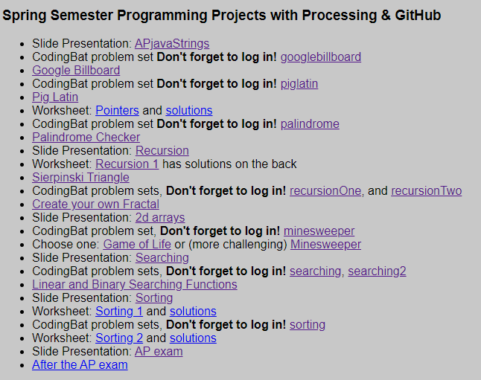
New Presentation: Sorting
‹#›

Slide 2
Sorting
Sorting is the process of putting something (e.g. an array) in order
There are many ways (algorithms) to do this
There is no, one single best way
Some ways, though, are much worse than others
Computer Scientists measure the efficiency of algorithms like sorts in Big O notation
‹#›

Slide 3
Sorting
On the AP exam you are not expected to code a sort
You are expected to be familiar with three different types of sorts:
Selection
Insertion
Merge Sort
You are also expected to be able to code the sorting “helper” functions merge and swap
‹#›

Slide 4
Timing and efficiency
One aspect of program efficiency is how much time the program takes to execute
Can you guess the other aspect of efficiency?
‹#›

Slide 5
What is the output of this code fragment?
int nCount = 0;
int n = 10;
for(int x = 0; x < n; x++){
for(int y = 0; y < n; y++){
nCount++;
}
}
System.out.println(nCount);
What would the output be if n was 5? or 20?
What effect does doubling n have on nCount?
‹#›

Slide 6
O(n²)
The nested loops are “multiplied"
The efficiency of this type of algorithm is O(n²)
Doubling n quadruples the amount of work
for(int x = 0; x < n; x++)
for(int y = 0; y < n; y++)
‹#›

Slide 7
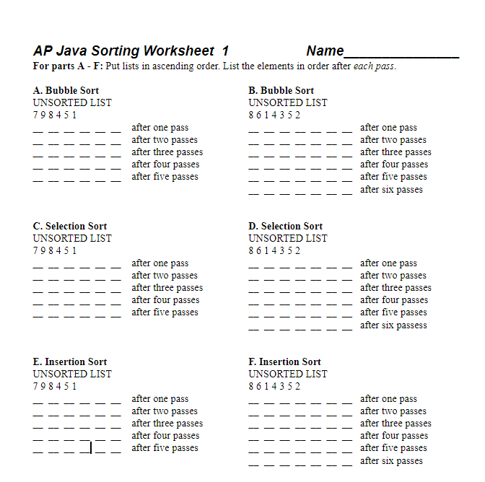
Due Friday 3/26 Sorting Worksheet 1
‹#›

Slide 8
O(n²) Sorting Algorithms
Characterized by nested loops
Bubble Sort
Selection Sort
Insertion Sort
Doubling the data Quadruples (4 x) the time it takes to sort
‹#›

Slide 9
Bubble Sort
Let's say we want to sort the following numbers: 12 34 18 5 7
We'll start by comparing the first two
12 34 18 5 7
‹#›

Slide 10
Bubble Sort
They are in order, so we'll go to the next two
12 34 18 5 7
‹#›

Slide 11
Bubble Sort
They aren't in order, so we'll swap them
12 18 34 5 7
‹#›

Slide 12
Bubble Sort
and so on. . .
12 18 34 5 7
‹#›

Slide 13
Bubble Sort
and so on. . .
12 18 5 34 7
‹#›

Slide 14
Bubble Sort
and so on. . .
12 18 5 34 7
‹#›

Slide 15
Bubble Sort
and so on. . .
12 18 5 7 34
‹#›

Slide 16
Bubble Sort
finally, after one pass through the numbers, the last number is in the correct position
Nest, we'll repeat the process, but we'll stop one position sooner.
12 18 5 7 34
‹#›

Slide 17
Bubble Sort
12 18 5 7 34
‹#›

Slide 18
Bubble Sort
12 18 5 7 34
‹#›

Slide 19
Bubble Sort
12 5 18 7 34
‹#›

Slide 20
Bubble Sort
12 5 18 7 34
‹#›

Slide 21
Bubble Sort
12 5 7 18 34
‹#›

Slide 22
Bubble Sort
12 5 7 18 34
‹#›

Slide 23
Bubble Sort
12 5 7 18 34
‹#›

Slide 24
Bubble Sort
5 12 7 18 34
‹#›

Slide 25
Bubble Sort
5 12 7 18 34
‹#›

Slide 26
Bubble Sort
5 7 12 18 34
‹#›

Slide 27
Bubble Sort
5 7 12 18 34
‹#›

Slide 28
Bubble Sort
5 7 12 18 34
‹#›

Slide 29
Bubble Sort
5 7 12 18 34
‹#›

Slide 30
Bubble Sort
Finally, the numbers are sorted
5 7 12 18 34
‹#›

Slide 31
Bubble Sort Animation
This is an “improved” bubble sort that stops early if no swap is performed for an entire pass
visualgo.net/bn/sorting
‹#›

Slide 32
Complete the chart
“One pass” means one loop through all the numbers
Bubble Sort
5 4 7 1 2 Unsorted List
_ _ _ _ _ After one pass
_ _ _ _ _ After two passes
_ _ _ _ _ After three passes
_ _ _ _ _ After four passes
‹#›

Slide 33
Complete the chart
Bubble Sort
5 4 7 1 2 Unsorted List
4 5 1 2 7 After one pass
_ _ _ _ _ After two passes
_ _ _ _ _ After three passes
_ _ _ _ _ After four passes
‹#›

Slide 34
Complete the chart
Bubble Sort
5 4 7 1 2 Unsorted List
4 5 1 2 7 After one pass
4 1 2 5 7 After two passes
_ _ _ _ _ After three passes
_ _ _ _ _ After four passes
‹#›

Slide 35
Complete the chart
Bubble Sort
5 4 7 1 2 Unsorted List
4 5 1 2 7 After one pass
4 1 2 5 7 After two passes
1 2 4 5 7 After three passes
_ _ _ _ _ After four passes
‹#›

Slide 36
Complete the chart
Bubble Sort
5 4 7 1 2 Unsorted List
4 5 1 2 7 After one pass
4 1 2 5 7 After two passes
1 2 4 5 7 After three passes
1 2 4 5 7 After four passes
‹#›

Slide 37
Pause here and complete A & B
‹#›

Slide 38
Check your answers at apcslowell.github.io
‹#›

Slide 39
Selection Sort
Selects the smallest element and swaps it into position
Like Bubble Sort, but with fewer swaps
We'll use a “flag” to keep track of the index of the smallest integer
Then we’ll do one swap at the end of each pass
12 34 18 5 7
flag = 0
‹#›

Slide 40
Selection Sort
12 34 18 5 7
flag = 0
‹#›

Slide 41
Selection Sort
12 34 18 5 7
flag = 0 3
‹#›

Slide 42
Selection Sort
12 34 18 5 7
flag = 3
‹#›

Slide 43
Selection Sort
After one pass through the numbers, we'll swap the position marked by the flag with the first number
12 34 18 5 7
flag = 3
‹#›

Slide 44
Selection Sort
After one pass through the numbers, we'll swap the position marked by the flag with the first number
5 34 18 12 7
flag = 3
‹#›

Slide 45
Selection Sort
The first number is now sorted, so we'll start the process again from the next position
5 34 18 12 7
flag = 1
‹#›

Slide 46
Selection Sort
5 34 18 12 7
flag = 2
‹#›

Slide 47
Selection Sort
5 34 18 12 7
flag = 3
‹#›

Slide 48
Selection Sort
5 34 18 12 7
flag = 4
‹#›

Slide 49
Selection Sort
5 7 18 12 34
flag = 4
‹#›

Slide 50
Selection Sort
5 7 18 12 34
flag = 2
‹#›

Slide 51
Selection Sort
5 7 18 12 34
flag = 3
‹#›

Slide 52
Selection Sort
5 7 12 18 34
flag = 3
‹#›

Slide 53
Selection Sort
5 7 12 18 34
flag = 3
‹#›

Slide 54
Selection Sort
5 7 12 18 34
flag = 3
‹#›

Slide 55
Insertion Sort
Insertion Sort starts by sorting the first part of the list
The first unsorted number is inserted into the sorted part of the list
12 34 18 5 7
‹#›

Slide 56
Insertion Sort
A single number by itself is sorted, so we will start with the first number as the sorted part of the list
We'll store the first number after the sorted section in a temporary variable
12 __ 18 5 7
temp = 34
‹#›

Slide 57
Insertion Sort
Where should we insert the 34? Do we need to “slide” the 12 over?
Notice that we are not considering the rest of the numbers
12 __ 18 5 7
temp = 34
‹#›

Slide 58
Insertion Sort
Do we need to “slide” the 34 over to make room for the 18? Do we “slide” the 12?
12 34 __ 5 7
temp = 18
‹#›

Slide 59
Insertion Sort
12 __ 34 5 7
temp = 18
‹#›

Slide 60
Insertion Sort
12 18 34 __ 7
temp = 5
‹#›

Slide 61
Insertion Sort
12 18 __ 34 7
temp = 5
‹#›

Slide 62
Insertion Sort
12 __ 18 34 7
temp = 5
‹#›

Slide 63
Insertion Sort
__ 12 18 34 7
temp = 5
‹#›

Slide 64
Insertion Sort
5 12 18 34 __
temp = 7
‹#›

Slide 65
Insertion Sort
5 12 18 __ 34
temp = 7
‹#›

Slide 66
Insertion Sort
5 12 __ 18 34
temp = 7
‹#›

Slide 67
Insertion Sort
5 __ 12 18 34
temp = 7
‹#›

Slide 68
Insertion Sort
5 7 12 18 34
temp = 7
‹#›

Slide 69
Selection
Insertion
‹#›
visualgo.net/bn/sorting

Slide 70
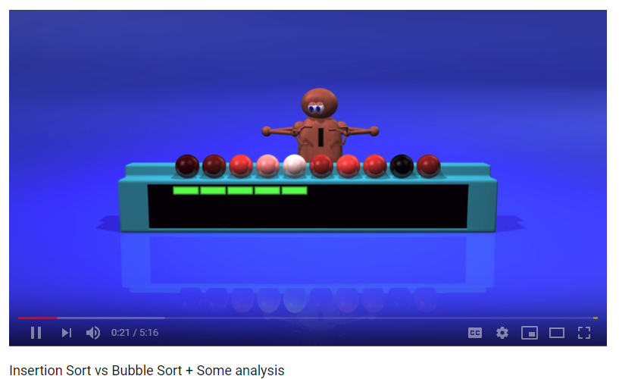
Insertion vs. Bubble Sort (stop at 4:25)
www.youtube.com/watch?v=TZRWRjq2CAg
‹#›

Slide 71
Complete the charts
Insertion Sort 5 4 7 1 2 Unsorted List
_ _ _ _ _ Insert pos #1
_ _ _ _ _ Insert pos #2
_ _ _ _ _ Insert pos #3
_ _ _ _ _ Insert pos #4
Selection Sort 5 4 7 1 2 Unsorted List
_ _ _ _ _ First pass
_ _ _ _ _ Second pass
_ _ _ _ _ Third pass
_ _ _ _ _ Fourth pass
‹#›

Slide 72
Complete the charts
Insertion Sort 5 4 7 1 2 Unsorted List
4 5 _ _ _ Insert pos #1
_ _ _ _ _ Insert pos #2
_ _ _ _ _ Insert pos #3
_ _ _ _ _ Insert pos #4
Selection Sort 5 4 7 1 2 Unsorted List
_ _ _ _ _ First pass
_ _ _ _ _ Second pass
_ _ _ _ _ Third pass
_ _ _ _ _ Fourth pass
‹#›

Slide 73
Complete the charts
Insertion Sort 5 4 7 1 2 Unsorted List
4 5 7 1 2 Insert pos #1
_ _ _ _ _ Insert pos #2
_ _ _ _ _ Insert pos #3
_ _ _ _ _ Insert pos #4
Selection Sort 5 4 7 1 2 Unsorted List
_ _ _ _ _ First pass
_ _ _ _ _ Second pass
_ _ _ _ _ Third pass
_ _ _ _ _ Fourth pass
‹#›

Slide 74
Complete the charts
Insertion Sort 5 4 7 1 2 Unsorted List
4 5 7 1 2 Insert pos #1
4 5 7 _ _ Insert pos #2
_ _ _ _ _ Insert pos #3
_ _ _ _ _ Insert pos #4
Selection Sort 5 4 7 1 2 Unsorted List
_ _ _ _ _ First pass
_ _ _ _ _ Second pass
_ _ _ _ _ Third pass
_ _ _ _ _ Fourth pass
‹#›

Slide 75
Complete the charts
Insertion Sort 5 4 7 1 2 Unsorted List
4 5 7 1 2 Insert pos #1
4 5 7 1 2 Insert pos #2
_ _ _ _ _ Insert pos #3
_ _ _ _ _ Insert pos #4
Selection Sort 5 4 7 1 2 Unsorted List
_ _ _ _ _ First pass
_ _ _ _ _ Second pass
_ _ _ _ _ Third pass
_ _ _ _ _ Fourth pass
‹#›

Slide 76
Complete the charts
Insertion Sort 5 4 7 1 2 Unsorted List
4 5 7 1 2 Insert pos #1
4 5 7 1 2 Insert pos #2
1 4 5 7 _ Insert pos #3
_ _ _ _ _ Insert pos #4
Selection Sort 5 4 7 1 2 Unsorted List
_ _ _ _ _ First pass
_ _ _ _ _ Second pass
_ _ _ _ _ Third pass
_ _ _ _ _ Fourth pass
‹#›

Slide 77
Complete the charts
Insertion Sort 5 4 7 1 2 Unsorted List
4 5 7 1 2 Insert pos #1
4 5 7 1 2 Insert pos #2
1 4 5 7 2 Insert pos #3
_ _ _ _ _ Insert pos #4
Selection Sort 5 4 7 1 2 Unsorted List
_ _ _ _ _ First pass
_ _ _ _ _ Second pass
_ _ _ _ _ Third pass
_ _ _ _ _ Fourth pass
‹#›

Slide 78
Complete the charts
Insertion Sort 5 4 7 1 2 Unsorted List
4 5 7 1 2 Insert pos #1
4 5 7 1 2 Insert pos #2
1 4 5 7 2 Insert pos #3
1 2 4 5 7 Insert pos #4
Selection Sort 5 4 7 1 2 Unsorted List
_ _ _ _ _ First pass
_ _ _ _ _ Second pass
_ _ _ _ _ Third pass
_ _ _ _ _ Fourth pass
‹#›

Slide 79
Complete the charts
Insertion Sort 5 4 7 1 2 Unsorted List
4 5 7 1 2 Insert pos #1
4 5 7 1 2 Insert pos #2
1 4 5 7 2 Insert pos #3
1 2 4 5 7 Insert pos #4
Selection Sort 5 4 7 1 2 Unsorted List
1 _ _ 5 _ First pass
_ _ _ _ _ Second pass
_ _ _ _ _ Third pass
_ _ _ _ _ Fourth pass
‹#›

Slide 80
Complete the charts
Insertion Sort 5 4 7 1 2 Unsorted List
4 5 7 1 2 Insert pos #1
4 5 7 1 2 Insert pos #2
1 4 5 7 2 Insert pos #3
1 2 4 5 7 Insert pos #4
Selection Sort 5 4 7 1 2 Unsorted List
1 4 7 5 2 First pass
_ _ _ _ _ Second pass
_ _ _ _ _ Third pass
_ _ _ _ _ Fourth pass
‹#›

Slide 81
Complete the charts
Insertion Sort 5 4 7 1 2 Unsorted List
4 5 7 1 2 Insert pos #1
4 5 7 1 2 Insert pos #2
1 4 5 7 2 Insert pos #3
1 2 4 5 7 Insert pos #4
Selection Sort 5 4 7 1 2 Unsorted List
1 4 7 5 2 First pass
_ 2 _ _ 4 Second pass
_ _ _ _ _ Third pass
_ _ _ _ _ Fourth pass
‹#›

Slide 82
Complete the charts
Insertion Sort 5 4 7 1 2 Unsorted List
4 5 7 1 2 Insert pos #1
4 5 7 1 2 Insert pos #2
1 4 5 7 2 Insert pos #3
1 2 4 5 7 Insert pos #4
Selection Sort 5 4 7 1 2 Unsorted List
1 4 7 5 2 First pass
1 2 7 5 4 Second pass
_ _ _ _ _ Third pass
_ _ _ _ _ Fourth pass
‹#›

Slide 83
Complete the charts
Insertion Sort 5 4 7 1 2 Unsorted List
4 5 7 1 2 Insert pos #1
4 5 7 1 2 Insert pos #2
1 4 5 7 2 Insert pos #3
1 2 4 5 7 Insert pos #4
Selection Sort 5 4 7 1 2 Unsorted List
1 4 7 5 2 First pass
1 2 7 5 4 Second pass
_ _ 4 _ 7 Third pass
_ _ _ _ _ Fourth pass
‹#›

Slide 84
Complete the charts
Insertion Sort 5 4 7 1 2 Unsorted List
4 5 7 1 2 Insert pos #1
4 5 7 1 2 Insert pos #2
1 4 5 7 2 Insert pos #3
1 2 4 5 7 Insert pos #4
Selection Sort 5 4 7 1 2 Unsorted List
1 4 7 5 2 First pass
1 2 7 5 4 Second pass
1 2 4 5 7 Third pass
_ _ _ _ _ Fourth pass
‹#›

Slide 85
Complete the charts
Insertion Sort 5 4 7 1 2 Unsorted List
4 5 7 1 2 Insert pos #1
4 5 7 1 2 Insert pos #2
1 4 5 7 2 Insert pos #3
1 2 4 5 7 Insert pos #4
Selection Sort 5 4 7 1 2 Unsorted List
1 4 7 5 2 First pass
1 2 7 5 4 Second pass
1 2 4 5 7 Third pass
_ _ _ 5 _ Fourth pass
‹#›

Slide 86
Complete the charts
Insertion Sort 5 4 7 1 2 Unsorted List
4 5 7 1 2 Insert pos #1
4 5 7 1 2 Insert pos #2
1 4 5 7 2 Insert pos #3
1 2 4 5 7 Insert pos #4
Selection Sort 5 4 7 1 2 Unsorted List
1 4 7 5 2 First pass
1 2 7 5 4 Second pass
1 2 4 5 7 Third pass
1 2 4 5 7 Fourth pass
‹#›

Slide 87
Pause here and complete C - F
‹#›

Slide 88
A bubble sort animation with dots
Instead of a bar graph, there is a dot at what would be the top of the bar
https://en.wikipedia.org/wiki/Bubble_sort#/media/File:Bubble_sort_animation.gif
‹#›

Slide 89
Insertion Sort:
White Dash at top with Red Bar graphs
http://www.algostructure.com/sorting/insertionsort.php
‹#›

Slide 90
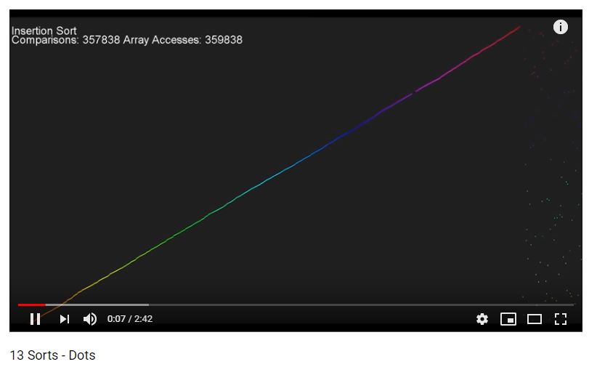
Video: 13 sorts with dots
‹#›

Slide 91
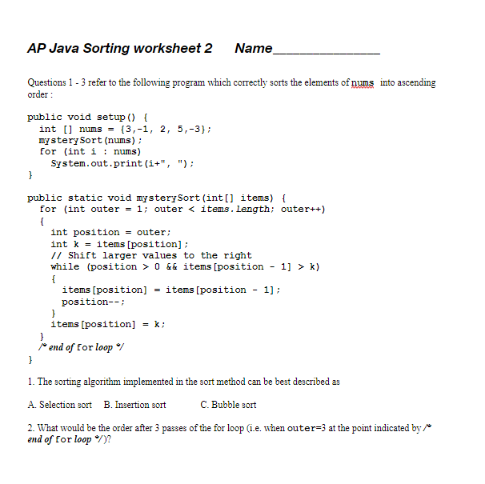
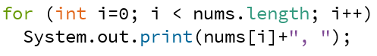
Sorting Worksheet 2 will give you practice in identifying the type of sort
This loop just prints the numbers
It’s the same as
You want to look at the code in mysterySort to identify which sort is used
‹#›

Slide 92
Bubble Sort is distinguished by frequent swapping
This is an “improved” bubble sort that stops early if no swap is performed for an entire pass
visualgo.net/bn/sorting
‹#›

Slide 93
Bubble Sort Code
public void bubbleSort(int[] list)
{
for (int outer = 0; outer < list.length - 1; outer++)
for (int inner = 0; inner < list.length - 1; inner++)
We'll start with some nested for loops that take us through the list of numbers
Since we’ll compare list[inner] with list[inner + 1] we’ll need to stop the loop 1 position early
I think of this as balancing
‹#›

Slide 94
Bubble Sort Code
public void bubbleSort(int[] list)
{
for (int outer = 0; outer < list.length - 1; outer++)
{
for (int inner = 0; inner < list.length-1; inner++)
{
if (list[inner] > list[inner + 1])
{
//swap list[inner] & list[inner+1]
int temp = list[inner];
list[inner] = list[inner + 1];
list[inner + 1] = temp;
}
}
}
}
‹#›

Slide 95
You can identity Bubble Sort code by the swap in the inner loop
public void bubbleSort(int[] list)
{
for (int outer = 0; outer < list.length - 1; outer++)
{
for (int inner = 0; inner < list.length-1; inner++)
{
if (list[inner] > list[inner + 1])
{
//swap list[inner] & list[inner+1]
int temp = list[inner];
list[inner] = list[inner + 1];
list[inner + 1] = temp;
}
}
}
}
‹#›

Slide 96
Improved Bubble Sort Code
public void bubbleSort(int[] list)
{
for (int outer = 0; outer < list.length - 1; outer++)
for (int inner = 0; inner < list.length-outer-1;
inner++)
We can improve the efficiency by stopping one position earlier after each pass of the outer loop so that we don’t revisit elements that are already sorted
list.length-outer-1
‹#›

Slide 97
Improved Bubble Sort Code
public void bubbleSort(int[] list)
{
for (int outer = 0; outer < list.length - 1; outer++)
{
for (int inner = 0; inner < list.length-outer-1;inner++)
{
if (list[inner] > list[inner + 1])
{
//swap list[inner] & list[inner+1]
int temp = list[inner];
list[inner] = list[inner + 1];
list[inner + 1] = temp;
}
}
}
}
‹#›

Slide 98
Checking for no swaps in a pass
public void bubbleSort(int[] list)
{
for (int outer = 0; outer < list.length - 1; outer++)
{
boolean noSwaps = true;
for (int inner = 0; inner < list.length-outer-1; inner++)
{
if (list[inner] > list[inner + 1])
{
//swap list[inner] & list[inner+1]
int temp = list[inner];
list[inner] = list[inner + 1];
list[inner + 1] = temp;
noSwaps = false;
}
}
if(noSwaps == true)
break;
}
}
‹#›

Slide 99
Selection Sort is distinguished by the flag and the single swap after each pass
‹#›
visualgo.net/bn/sorting

Slide 100
Selection Sort Code
public void selectionSort(int[] list)
{
int flag, temp;
for (int outer = 0; outer < list.length - 1; outer++){
flag = outer;
for (int inner = outer + 1; inner < list.length; inner++){
if (list[inner] < list[flag])
flag = inner;
}
//swap list[outer] & list[flag]
temp = list[outer];
list[outer] = list[flag];
list[flag] = temp;
}
}
‹#›

Slide 101
You can identity Selection sort code by the flag and the swap after inner loop
flag = outer;
for (int inner = outer + 1; inner < list.length; inner++){
if (list[inner] < list[flag])
{
flag = inner;
}
}
//swap list[outer] & list[flag]
temp = list[outer];
list[outer] = list[flag];
list[flag] = temp;
The flag, stores the index of the smallest number
Don't confuse flag with list[flag]
That's like confusing the apartment number with the person who lives in that apartment
‹#›

Slide 102
Insertion Sort is distinguished by how the elements “slide” to make room for the insertion
‹#›
visualgo.net/bn/sorting

Slide 103
Insertion Sort Code
public void insertionSort(int[] list){
for (int outer = 1; outer < list.length; outer++)
{
int position = outer;
int key = list[position];
// Shift larger values to the right
while (position > 0 && list[position - 1] > key)
{
list[position] = list[position - 1];
position--;
}
list[position] = key;
}
}
‹#›

Slide 104
You can identify Insertion Sort code by the “sliding” of elements by 1 position
public void insertionSort(int[] list){
for (int outer = 1; outer < list.length; outer++)
{
int position = outer;
int key = list[position];
// Shift larger values to the right
while (position > 0 && list[position - 1] > key)
{
list[position] = list[position - 1];
position--;
}
list[position] = key;
}
}
‹#›

Slide 105
Sorting Worksheet 2 will give you practice in identifying the type of sort
This loops just prints the numbers
It’s the same as
You want to look at the code in mysterySort to identify which sort is used
‹#›

Slide 106
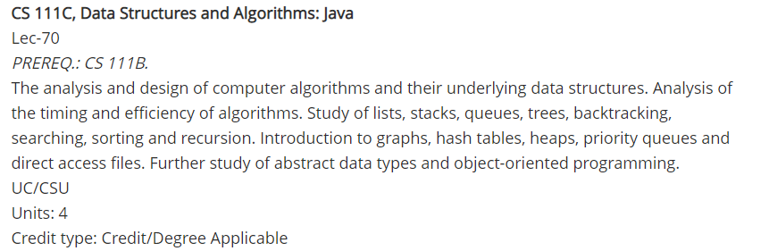
Computer Science at CCSF
AP Computer Science A is equivalent to CS 111B at CCSF
The logical next step after this class would be CS 111C, Data Structures and Algorithms: Java
Credits accepted at both UC and CSU
Full list of CCSF computer science classes at www.ccsf.edu/academics/ccsf-catalog/courses-by-department/computer-science
‹#›

Slide 107
Computer Science at CCSF
You could also take any CS course that lists CS 111B as a prerequisite:
CS 131B, Programming Fundamentals: Python UC/CSU
CS 112, Beginning iPhone Programming using Swift CSU only
CS 150A, Introduction to SQL Databases and NoSQL CSU only
CS 160A, Introduction to Unix/Linux UC/CSU
‹#›

Slide 108
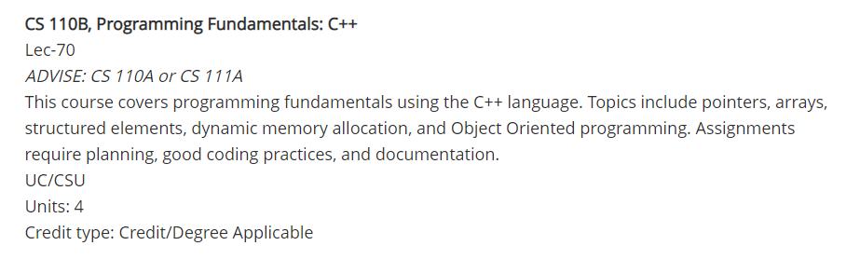
Computer Science at CCSF
CS 110B covers the same topics as AP CS A but in a different language C++:
‹#›

Slide 109
Computer Science at CCSF
Programming for Web sites:
CS 142, Programming Techniques for XML CSU only
CS 130A, PHP Programming CSU only
CS 132A, Ruby Programming CSU only
‹#›

Slide 110

Computer Science at CCSF
Game Programming:
CS 185, Exploring Game Worlds (Unity) CSU only
Engineering:
CS 177, Software Engineering UC/CSU
‹#›

Slide 111
Other Community Colleges that offer Computer Science courses
Ohlone
Skyline
San Mateo
Diablo Valley
Berkeley
De Anza
Foothill
and many others. . .
‹#›

Slide 112
What are you expected to know about sorting on the AP exam?
You are not expected to write code for a sort
You are expected to recognize the code for the 3 tested sorts:
Selection
Insertion
Merge sort (coming soon!)
You are expected to be write code that swaps and merges
‹#›

Slide 113
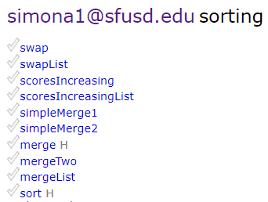
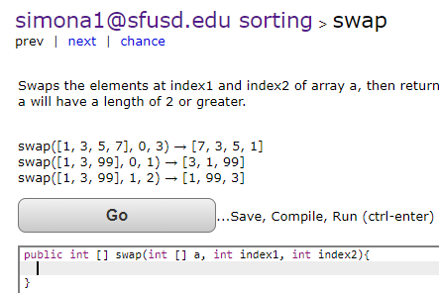
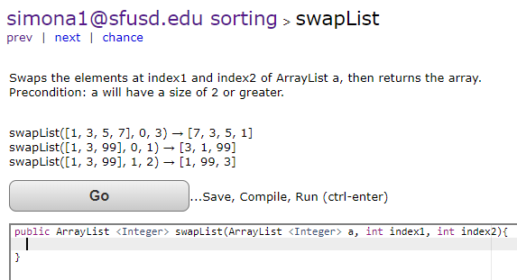
The sorting codingbat problem set starts with two swap problems
‹#›

Slide 114
Let’s say I want to swap the elements in positions index1 and index2 in array a
a
5
3
2
7
9
4
1
[0]
[1]
[2]
[3]
[4]
[5]
[6]
index1
2
index2
5
‹#›

Slide 115
The common mistake is to try to swap without a 3rd variable
a
5
3
2
7
9
4
1
[0]
[1]
[2]
[3]
[4]
[5]
[6]
index1
2
index2
5
‹#›

Slide 116
The common mistake is to try to swap without a 3rd variable
a
5
3
2
7
9
4
1
[0]
[1]
[2]
[3]
[4]
[5]
[6]
index1
2
a[index1] = a[index2];
index2
5
‹#›

Slide 117
The common mistake is to try to swap without a 3rd variable
a
5
3
2
7
9
4
1
X
[0]
[1]
[2]
[3]
[4]
[5]
[6]
index1
2
a[index1] = a[index2];
index2
5
‹#›

Slide 118
The common mistake is to try to swap without a 3rd variable
a
5
3
4
7
9
4
1
[0]
[1]
[2]
[3]
[4]
[5]
[6]
index1
2
a[index1] = a[index2];
index2
5
‹#›

Slide 119
The common mistake is to try to swap without a 3rd variable
a
5
3
4
7
9
4
1
[0]
[1]
[2]
[3]
[4]
[5]
[6]
index1
2
a[index1] = a[index2];
a[index2] = a[index1];
index2
5
‹#›

Slide 120
The common mistake is to try to swap without a 3rd variable
a
5
3
4
7
9
4
1
X
[0]
[1]
[2]
[3]
[4]
[5]
[6]
index1
2
a[index1] = a[index2];
a[index2] = a[index1];
index2
5
‹#›

Slide 121
The common mistake is to try to swap without a 3rd variable
a
5
3
4
7
9
4
1
[0]
[1]
[2]
[3]
[4]
[5]
[6]
index1
2
a[index1] = a[index2];
a[index2] = a[index1];
index2
5
‹#›

Slide 122
So let's start with a temp variable
a
5
3
2
7
9
4
1
temp
2
[0]
[1]
[2]
[3]
[4]
[5]
[6]
index1
2
int temp = a[index1];
index2
5
temp
2
‹#›

Slide 123
Now copy a[index2] into a[index1]
a
5
3
2
7
9
4
1
temp
2
[0]
[1]
[2]
[3]
[4]
[5]
[6]
index1
2
int temp = a[index1];
a[index1] = a[index2];
index2
5
temp
2
‹#›

Slide 124
Now copy a[index2] into a[index1]
a
5
3
2
7
9
4
1
X
temp
2
[0]
[1]
[2]
[3]
[4]
[5]
[6]
index1
2
int temp = a[index1];
a[index1] = a[index2];
index2
5
temp
2
‹#›

Slide 125
Now copy a[index2] into a[index1]
a
5
3
4
7
9
4
1
temp
2
[0]
[1]
[2]
[3]
[4]
[5]
[6]
index1
2
int temp = a[index1];
a[index1] = a[index2];
index2
5
temp
2
‹#›

Slide 126
Now copy temp into a[index2]
a
5
3
4
7
9
4
1
temp
2
[0]
[1]
[2]
[3]
[4]
[5]
[6]
index1
2
int temp = a[index1];
a[index1] = a[index2];
a[index2] = temp;
index2
5
temp
2
‹#›

Slide 127
Now copy temp into a[index2]
a
5
3
4
7
9
4
1
X
temp
2
[0]
[1]
[2]
[3]
[4]
[5]
[6]
index1
2
int temp = a[index1];
a[index1] = a[index2];
a[index2] = temp;
index2
5
temp
2
‹#›

Slide 128
The swap is completed successfully
a
5
3
4
7
9
2
1
temp
2
[0]
[1]
[2]
[3]
[4]
[5]
[6]
index1
2
int temp = a[index1];
a[index1] = a[index2];
a[index2] = temp;
index2
5
temp
2
‹#›

Slide 129
Here's a clever idea
With an O(n²) sort, doubling the number of numbers quadruples the work
So let's say 5 numbers takes 40 nanoseconds to sort
How many nanoseconds would 10 numbers take?
‹#›

Slide 130
Here's a clever idea
With an O(n²) sort, doubling the number of numbers quadruples the work
So let's say 5 numbers takes 40 nanoseconds to sort
Sorting 10 numbers would take 160 nanoseconds
What if we sorted those 10 numbers 5 at a time?
Would that save time?
‹#›

Slide 131
Here's a clever idea
{6,2,1,3,9,8,5,7,4,0}
becomes
{6,2,1,3,9} {8,5,7,4,0}
How many nanoseconds to sort each group of 5?
‹#›

Slide 132
Here's a clever idea
{6,2,1,3,9,8,5,7,4,0}
becomes
{6,2,1,3,9} {8,5,7,4,0}
and with 80 nanoseconds (40 for each) I have
{1,2,3,6,9} {0,4,5,7,8}
So if I can figure out how to combine them into one sorted group in less than another 80 nanoseconds I'll be ahead
‹#›

Slide 133
Merging
Merging is combining two smaller sorted groups into one larger sorted group
{1,2,3,6,9} {0,4,5,7,8}
It only takes one pass (loop) through the numbers, so it's faster than nested loop sorting
Like Binary Search, this is another example of a Divide and Conquer algorithm
‹#›

Slide 134
Merging
I'll set up an empty array* to hold the final sorted numbers
{1,2,3,6,9} {0,4,5,7,8} { }
I'll start with the first two numbers, and copy the smaller number into the empty array
*A sort that uses an extra array to store the result is sometimes called an out of place sort
‹#›

Slide 135
Merging
{1,2,3,6,9} {0,4,5,7,8} {0 }
I'll I'll move to the next number, and copy the smaller
‹#›

Slide 136
Merging
{1,2,3,6,9} {0,4,5,7,8} {0,1}
an so on. . .
‹#›

Slide 137
Merging
{1,2,3,6,9} {0,4,5,7,8} {0,1,2}
an so on. . .
‹#›

Slide 138
Merging
{1,2,3,6,9} {0,4,5,7,8} {0,1,2,3}
an so on. . .
‹#›

Slide 139
Merging
{1,2,3,6,9} {0,4,5,7,8} {0,1,2,3,4}
an so on. . .
‹#›

Slide 140
Merging
{1,2,3,6,9} {0,4,5,7,8} {0,1,2,3,4,5}
an so on. . .
‹#›

Slide 141
Merging
{1,2,3,6,9} {0,4,5,7,8} {0,1,2,3,4,5,6}
an so on. . .
‹#›

Slide 142
Merging
{1,2,3,6,9} {0,4,5,7,8} {0,1,2,3,4,5,6,7}
an so on. . .
‹#›

Slide 143
Merging
{1,2,3,6,9} {0,4,5,7,8} {0,1,2,3,4,5,6,7,8}
we I get to the end of one group, I can just copy the rest over
‹#›

Slide 144
Merging
{1,2,3,6,9} {0,4,5,7,8} {0,1,2,3,4,5,6,7,8,9}
we I get to the end of one group, I can just copy the rest over
‹#›

Slide 145
Merging is not sorting!
A merge function does not sort
A merge is a “helper” function that merges two smaller sorted partitions of an array into one larger sorted partition
A merge function increases the efficiency of a sort, and it can be used with insertion, selection, bubble or any other sort
A merge function only works with data that is already sorted
‹#›

Slide 146
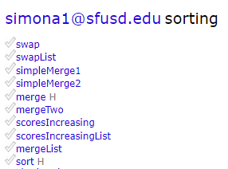
simpleMerge1 simpleMerge2
are the easiest merges in the codingbat problem set
Don’t forget to log in!
‹#›

Slide 147
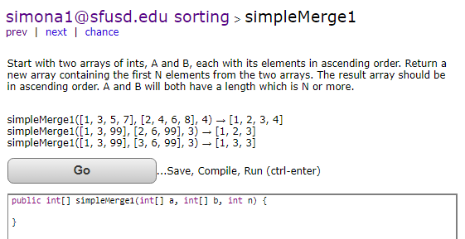
simpleMerge1
‹#›

Slide 148
simpleMerge1
simpleMerge1(
{1, 3, 5, 7}, {2, 3, 6, 8}, 4)
→ (returns) {1, 2, 3, 3}
‹#›

Slide 149
simpleMerge1
public int[] simpleMerge1(
int[] a, int[] b, int n) {
??
}
‹#›

Slide 150
simpleMerge1
public int[] simpleMerge1(
int[] a, int[] b, int n) {
return ??;
}
‹#›

Slide 151
simpleMerge1
public int[] simpleMerge1(
int[] a, int[] b, int n) {
int [] c = new int[n];
return ??;
}
‹#›

Slide 152
simpleMerge1
public int[] simpleMerge1(
int[] a, int[] b, int n) {
int [] c = new int[n];
return c;
}
‹#›

Slide 153
simpleMerge1
public int[] simpleMerge1(
int[] a, int[] b, int n) {
int [] c = new int[n];
??
return c;
}
‹#›

Slide 154
simpleMerge1
simpleMerge1(
{1, 3, 5, 7}, {2, 3, 6, 8}, 4)
‹#›

Slide 155
simpleMerge1
simpleMerge1(
{1, 3, 5, 7}, {2, 3, 6, 8}, 4)
{_, _, _, _}
‹#›

Slide 156
simpleMerge1
simpleMerge1(
{1, 3, 5, 7}, {2, 3, 6, 8}, 4)
{_, _, _, _}
‹#›

Slide 157
simpleMerge1
simpleMerge1(
{1, 3, 5, 7}, {2, 3, 6, 8}, 4)
{1, _, _, _}
‹#›

Slide 158
simpleMerge1
simpleMerge1(
{1, 3, 5, 7}, {2, 3, 6, 8}, 4)
{1, 2, _, _}
‹#›

Slide 159
simpleMerge1
simpleMerge1(
{1, 3, 5, 7}, {2, 3, 6, 8}, 4)
{1, 2, 3, _}
‹#›

Slide 160
simpleMerge1
simpleMerge1(
{1, 3, 5, 7}, {2, 3, 6, 8}, 4)
{1, 2, 3, 3}
‹#›

Slide 161
simpleMerge1
public int[] simpleMerge1(
int[] a, int[] b, int n) {
int [] c = new int[n];
for(int i=0;i<??;i++)
{
}
return c;
}
‹#›

Slide 162
simpleMerge1
public int[] simpleMerge1(
int[] a, int[] b, int n) {
int [] c = new int[n];
for(int i=0;i<n;i++)
{
}
return c;
}
‹#›

Slide 163
simpleMerge1
public int[] simpleMerge1(
int[] a, int[] b, int n) {
int [] c = new int[n];
for(int i=0;i<n;i++)
{
??
}
return c;
}
‹#›

Slide 164
simpleMerge1
public int[] simpleMerge1(
int[] a, int[] b, int n) {
int [] c = new int[n];
for(int i=0;i<n;i++)
{
c[i] = ??
}
return c;
}
‹#›

Slide 165
simpleMerge1
public int[] simpleMerge1(
int[] a, int[] b, int n) {
int [] c = new int[n];
for(int i=0;i<n;i++)
{
if(a[??] < b[??])
{
c[i] = ??
}
}
return c;
}
‹#›

Slide 166
simpleMerge1
public int[] simpleMerge1(
int[] a, int[] b, int n) {
int [] c = new int[n];
int nA = 0; //index of A
int nB = 0; //index of B
for(int i=0;i<n;i++)
if(a[nA] < b[nB]){
c[i] = ??
??
}else ??
}
return c;
}
‹#›

Slide 167
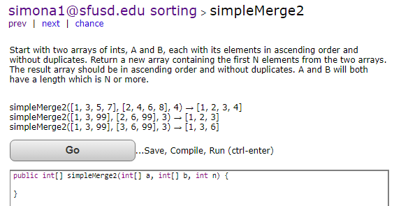
simpleMerge2 – what’s different?
‹#›

Slide 168
simpleMerge2 – no duplicates
‹#›

Slide 169
Merging is combining two sorted groups into one
{1,2,3,6,9} {0,4,5,7,8} {0,1,2,3,4,5,6,7,8,9}
By splitting a group of values into two parts and sorting those parts first and then merging them together we can improve the efficiency of any sort
This is an example of a divide and conquer strategy
‹#›

Slide 170
When merging, how small should the groups be?
If dividing the values to be sorted into 2 groups saves time, would 4 be better?
‹#›

Slide 171
How small should the groups be?
If dividing the values to be sorted into 2 groups saves time, would 4 be better?
YES!
‹#›

Slide 172
How small should the groups be?
If dividing the values to be sorted into 4 groups saves time, would 8 be better?
‹#›

Slide 173
How small should the groups be?
If dividing the values to be sorted into 4 groups saves time, would 8 be better?
YES!
‹#›

Slide 174
Merge Sort
Merge Sort is a sorting algorithm that uses the merge helper function to its maximum advantage
‹#›

Slide 175

Merge Sort (stop at 2:20)
www.youtube.com/watch?v=es2T6KY45cA
‹#›

Slide 176
Merge Sort Animation
‹#›
visualgo.net/bn/sorting

Slide 177
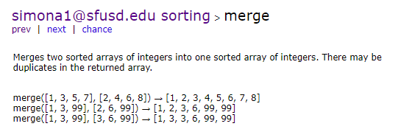
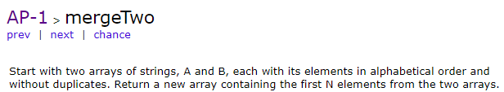
merge & mergeTwo Don’t forget to log in!
Note for mergeTwo: use
if(a[nA].compareTo(b[nB]) < 0) instead of if(a[nA] < b[nB])
‹#›

Slide 178
merge
merge({1, 3, 5, 7}, {2, 4, 6, 8})
→ (returns) {1,2,3,4,5,6,7,8}
‹#›

Slide 179
merge
public int[] merge(int[] a, int[] b)
{
??
}
‹#›

Slide 180
merge
public int[] merge(int[] a, int[] b)
{
return ??;
}
‹#›

Slide 181
merge
public int[] merge(int[] a, int[] b)
{
int [] c = new int[?];
return ??;
}
‹#›

Slide 182
merge
public int[] merge(int[] a, int[] b)
{
int [] c = new
int[a.length+b.length];
return ??;
}
‹#›

Slide 183
merge
public int[] merge(int[] a, int[] b)
{
int [] c = new
int[a.length+b.length];
return c;
}
‹#›

Slide 184
merge
public int[] merge(int[] a, int[] b)
{
int [] c = new
int[a.length+b.length];
??
return c;
}
‹#›

Slide 185
merge
merge({1, 3, 5, 7}, {2, 4, 6, 8})
{_, _, _, _, _, _, _, _}
‹#›

Slide 186
merge
merge({1, 3, 5, 7}, {2, 4, 6, 8})
{_, _, _, _, _, _, _, _}
‹#›

Slide 187
merge
merge({1, 3, 5, 7}, {2, 4, 6, 8})
{1, _, _, _, _, _, _, _}
‹#›

Slide 188
merge
merge({1, 3, 5, 7}, {2, 4, 6, 8})
{1, 2, _, _, _, _, _, _}
‹#›

Slide 189
merge
merge({1, 3, 5, 7}, {2, 4, 6, 8})
{1, 2, 3, 4, 5, 6, 7, _}
‹#›

Slide 190
merge
public int[] merge(int[] a, int[] b){
int [] c = new int[a.length+b.length];
int nA = 0;
int nB = 0;
for(int i =0;i<c.length;i++)
if(nA>=a.length)
??
return c;
}
‹#›

Slide 191
merge
public int[] merge(int[] a, int[] b){
//code not shown
for(int i =0;i<c.length;i++){
if(nA>=a.length)
??
else if(nB>=b.length)
??
else if(a[nA]<b[nB])
??
else
??
}
return c;
}
‹#›

Slide 192
codingbat AP-1 mergeTwo
http://codingbat.com/prob/p139150
Start with two arrays of strings, A and B, each with its elements in alphabetical order and without duplicates. Return a new array containing the first N elements from the two arrays. The result array should be in alphabetical order and without duplicates. A and B will both have a length which is N or more.
‹#›

Slide 193
mergeTwo(String[] a, String[] b, int n) mergeTwo({"a", "c", "z"}, {"b", "f", "z"}, 3)
Three arguments:
String[] a
String[] b
int n
‹#›

Slide 194
mergeTwo(String[] a, String[] b, int n) mergeTwo({"a", "c", "z"}, {"b", "f", "z"}, 3)
The first thing I need is a new String array of the right size
String [] c= new String[?];
‹#›

Slide 195
mergeTwo(String[] a, String[] b, int n) mergeTwo({"a", "c", "z"}, {"b", "f", "z"}, 3)
We want a solution that will work with any size
String [] c= new String[n];
‹#›

Slide 196
mergeTwo({"a", "c", "z"}, {"b", "f", "z"}, 3)
String [] c= new String[n];
I'll also need two index variables, one for each of the a and b arrays
int nA=0,nB=0;
‹#›

Slide 197
mergeTwo({"a", "c", "z"}, {"b", "f", "z"}, 3)
nA
nB
for(int i = 0; i<n; i++)
{ ?? , ?? , ?? } //c
i
‹#›

Slide 198
mergeTwo({"a", "c", "z"}, {"b", "f", "z"}, 3)
nA
nB
{ "a" , ?? , ?? } //c
i
‹#›

Slide 199
mergeTwo({"a", "c", "z"}, {"b", "f", "z"}, 3)
nA
nB
{ "a" , "b" , ?? } //c
i
‹#›

Slide 200
mergeTwo({"a", "c", "z"}, {"b", "f", "z"}, 3)
nA
nB
{ "a" , "b" , "c" } //c
i
and stop!
‹#›

Slide 201
mergeTwo({"a", "c", "z"}, {"c", "f", "z"}, 3)
nA
nB
{ ?? , ?? , ?? }
i
‹#›

Slide 202
mergeTwo({"a", "c", "z"}, {"c", "f", "z"}, 3)
nA
nB
{ "a" , ?? , ?? }
i
‹#›

Slide 203
mergeTwo({"a", "c", "z"}, {"c", "f", "z"}, 3)
nA
nB
{ "a" , "c" , ?? }
i
‹#›

Slide 204
mergeTwo({"a", "c", "z"}, {"c", "f", "z"}, 3)
nA
nB
{ "a" , "c" , "f" }
i
and stop!
‹#›

Slide 205
comparing Strings
< and > don't work
‹#›

Slide 206
comparing Strings
use compareTo instead
public String[] mergeTwo(
String[] a, String[] b, int n)
{
//lots of java
if(a[nA].compareTo(b[nB]) < 0)
‹#›

Slide 207
comparing Strings
< and > don't work
if(a[nA].compareTo(b[nB]) < 0)
If the element in a at position nA comes before b[nB] alphabetically
‹#›

Slide 208
comparing Strings
< and > don't work
if(a[nA].compareTo(b[nB]) > 0)
If the element in a at position nA comes after b[nB] alphabetically
‹#›

Slide 209
comparing Strings
< and > don't work
if(a[nA].compareTo(b[nB]) == 0)
If the element in a at position nA is the same as b[nB] alphabetically
‹#›

Slide 210
Using a merge function
A merge function is a helper function that can be used to improve the efficiency of any type of sort
public void merge(
int[] a, int first, int mid, int last)
//code not shown
‹#›

Slide 211
Using a merge function
First I'll rewrite my sort so that it only sorts part of the numbers, not all of them
public void selectionSort(
int[] list, int first, int last)
//sorts list from positions first to last
//code not shown
Then, I'll write a merge function that merges the numbers from first to mid, and mid + 1 to last
public void merge(
int[] a, int first, int mid, int last)
//code not shown
‹#›

Slide 212
How it could work
int[] list = {6,2,1,3,9,8,5,7,4,0};
selectionSort(list,0,4);
‹#›

Slide 213
How it could work
int[] list = {6,2,1,3,9,8,5,7,4,0};
selectionSort(list,0,4);
//sorts {6,2,1,3,9} to {1,2,3,6,9}
//list is now {1,2,3,6,9,8,5,7,4,0};
‹#›

Slide 214
How it could work
int[] list = {6,2,1,3,9,8,5,7,4,0};
selectionSort(list,0,4);
//sorts {6,2,1,3,9} to {1,2,3,6,9}
//list is now {1,2,3,6,9,8,5,7,4,0};
selectionSort(list,5,9);
‹#›

Slide 215
How it could work
int[] list = {6,2,1,3,9,8,5,7,4,0};
selectionSort(list,0,4);
//sorts {6,2,1,3,9} to {1,2,3,6,9}
//list is now {1,2,3,6,9,8,5,7,4,0};
selectionSort(list,5,9);
//sorts {8,5,7,4,0} to {0,4,5,7,8}
//list is now {1,2,3,6,9,0,4,5,7,8};
‹#›

Slide 216
How it could work
int[] list = {6,2,1,3,9,8,5,7,4,0};
selectionSort(list,0,4);
//sorts {6,2,1,3,9} to {1,2,3,6,9}
//list is now {1,2,3,6,9,8,5,7,4,0};
selectionSort(list,5,9);
//sorts {8,5,7,4,0} to {0,4,5,7,8}
//list is now {1,2,3,6,9,0,4,5,7,8};
merge(list,0,4,9);
‹#›

Slide 217
How it could work
int[] list = {6,2,1,3,9,8,5,7,4,0};
selectionSort(list,0,4);
//sorts {6,2,1,3,9} to {1,2,3,6,9}
//list is now {1,2,3,6,9,8,5,7,4,0};
selectionSort(list,5,9);
//sorts {8,5,7,4,0} to {0,4,5,7,8}
//list is now {1,2,3,6,9,0,4,5,7,8};
merge(list,0,4,9);
//merges {1,2,3,6,9}
//and {0,4,5,7,8}
//list is now {0,1,2,3,4,5,6,7,8,9}
‹#›

Slide 218
What is the output?
int[] arrayrray = {4,7,-2,4,1,13,8};
int nFirst = 0;
int nLast = arrayrray.length - 1;
int nMid = (nFirst + nLast)/2;
//nMid is last position in first part of array
selectionSort(arrayrray,nFirst,nMid);
display(arrayrray);
selectionSort(arrayrray,nMid + 1,nLast);
display(arrayrray);
merge(arrayrray,nFirst,nMid,nLast);
display(arrayrray);
public void display(int[] naList)
{
for(int nI = 0; nI < naList.length; nI++)
System.out.print(naList[nI] + ", ");
System.out.println();
}
public void selectionSort(int[] list, int first, int last)
//sorts list from positions first to last
//code not shown
public void merge(int[] a, int first, int mid, int last)
//code not shown
‹#›

Slide 219
What is the output? How would it change if the code in red was 2?
char [] letters = {'c', 'b','e','a','d'};
//bubble sort the list of letters
for(int nI = 0; nI < letters.length; nI++)
for(int nJ = 0; nJ < letters.length - nI -1; nJ++)
{
if(letters[nJ] > letters[nJ+1])
// if letters[nJ] comes after
// letters[nJ + 1] alphabetically
{
char temp = letters[nJ];
letters[nJ] = letters[nJ + 1];
letters[nJ + 1] = temp;
}
}
for(int nK = 0; nK < letters.length; nK++)
System.out.print(letters[nK]);
‹#›

Slide 220
What is the output?
public void setup()
{
int [] naNums = {7, -2, 5, -11, 67};
int nMyst = mystery(naNums);
System.out.println(nMyst);
System.out.println(naNums[nMyst]);
}
public int mystery(int [] naInts)
{
int flag = 0;
for (int nI = 1; nI < naInts.length; nI++)
{
if (naInts[nI] < naInts[flag])
{
System.out.println("Flag changed to " + nI);
flag = nI;
}
}
return flag;
}
‹#›

Slide 221
What is the output? How would it change if the code in red was 1? 3?
char [] letters = {'c', 'b','e','a','d'};
//insertion sort the letters of the array
for (int outer = 1; outer < letters.length; outer++)
{
int position = outer;
char key = letters[position];
// Shift larger values to the right
while (position > 0 && letters[position - 1] > key)
{
letters[position] = letters[position - 1];
position--;
}
letters[position] = key;
}
for(char let : letters)
System.out.print(let);
‹#›

